Slide 1
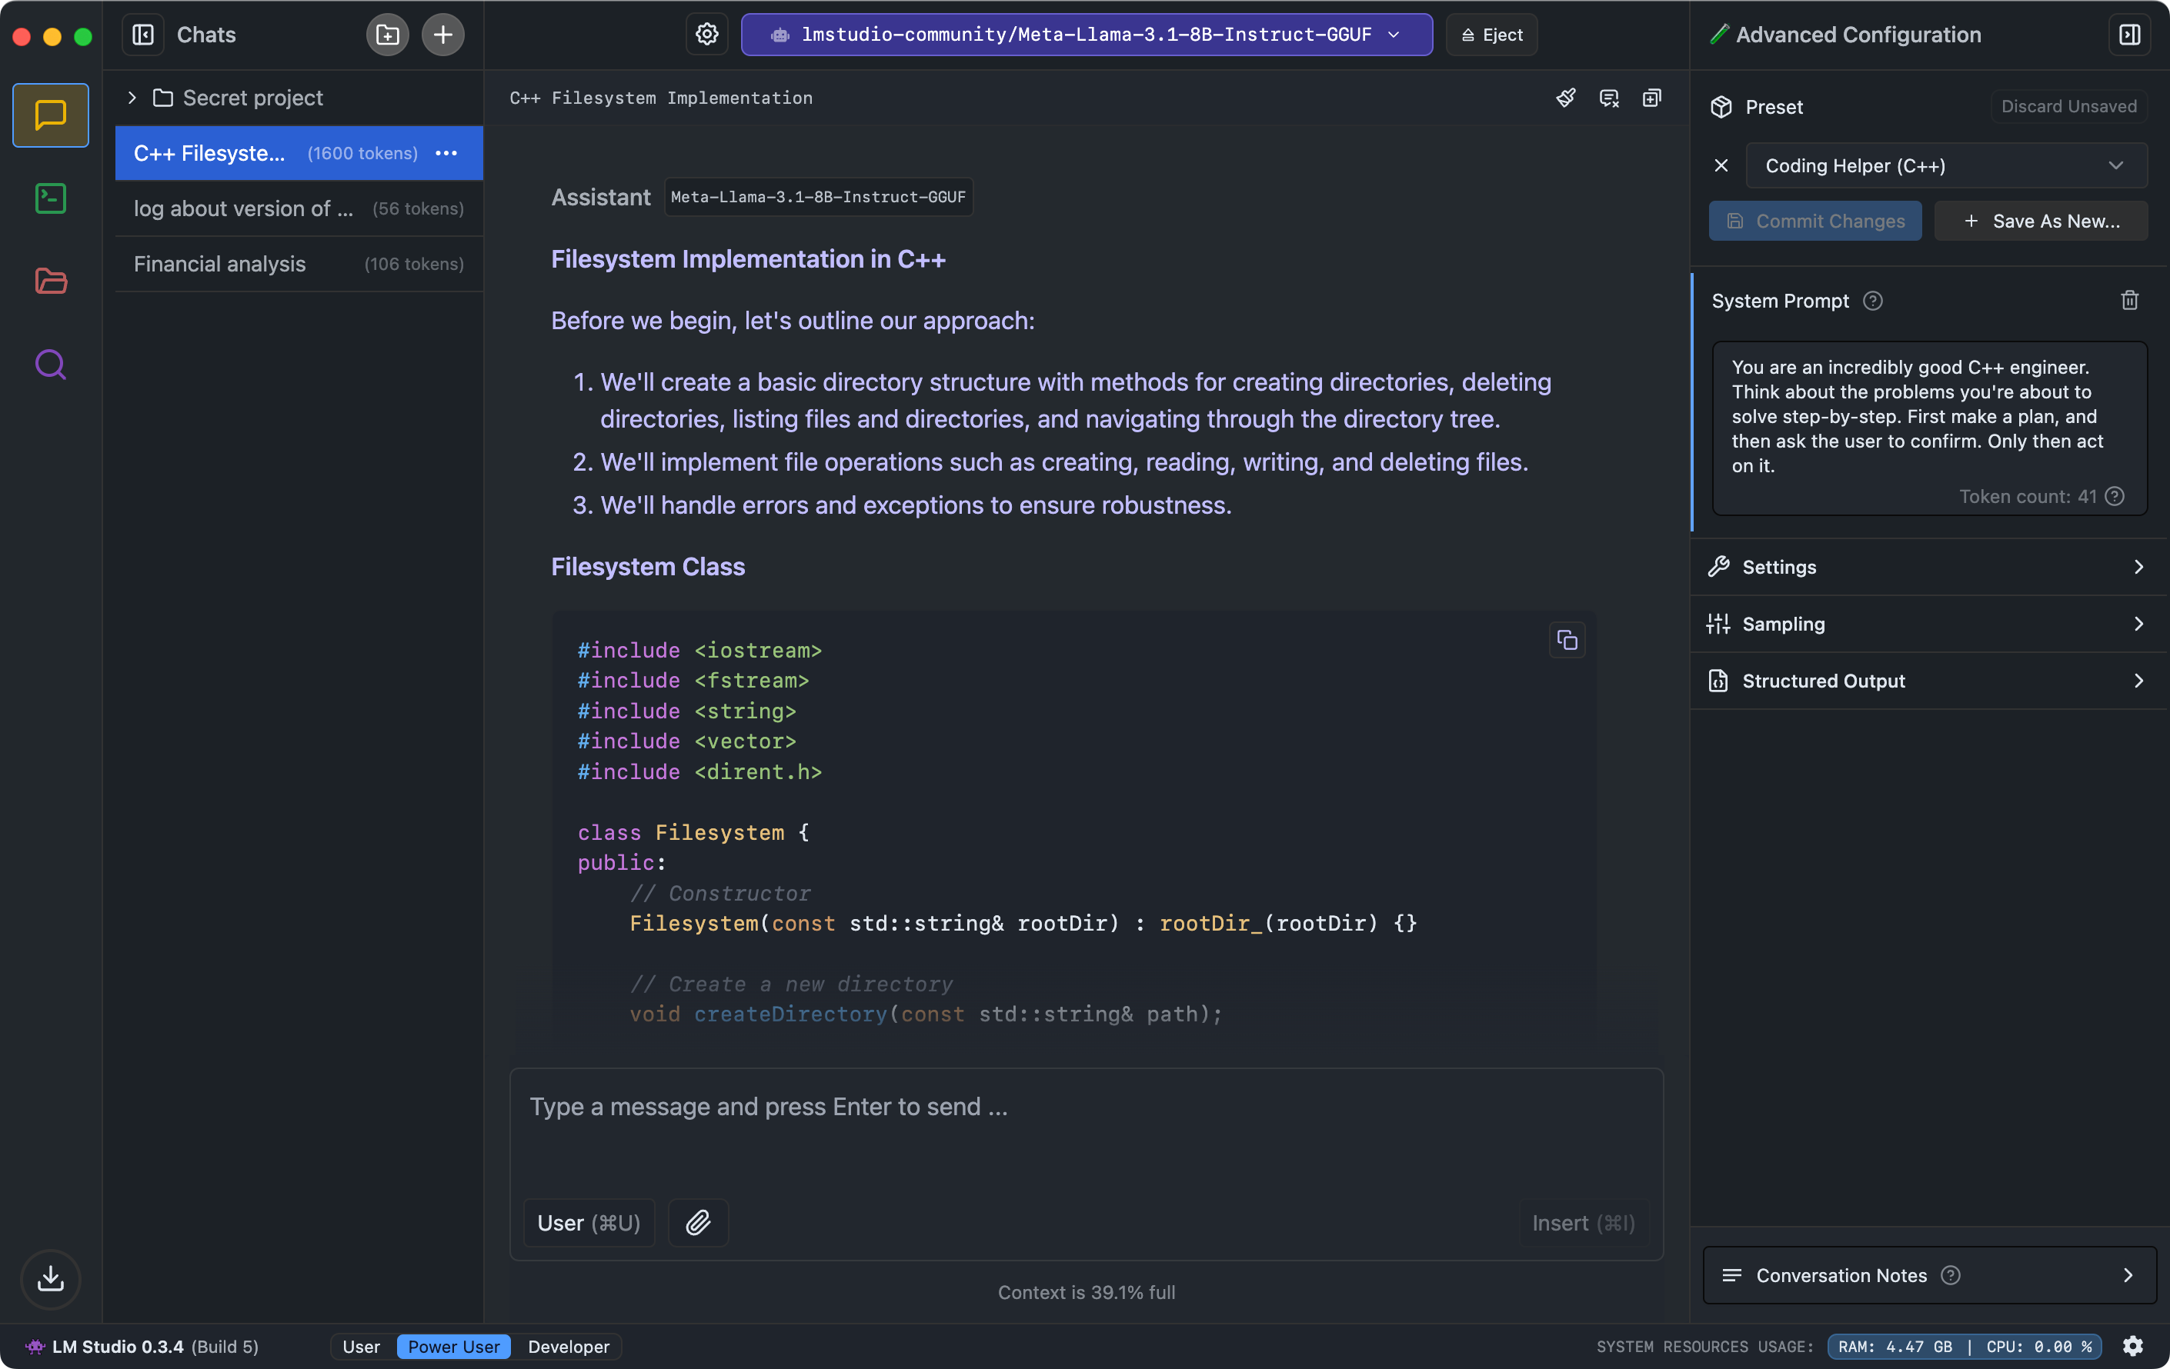

Slide 2
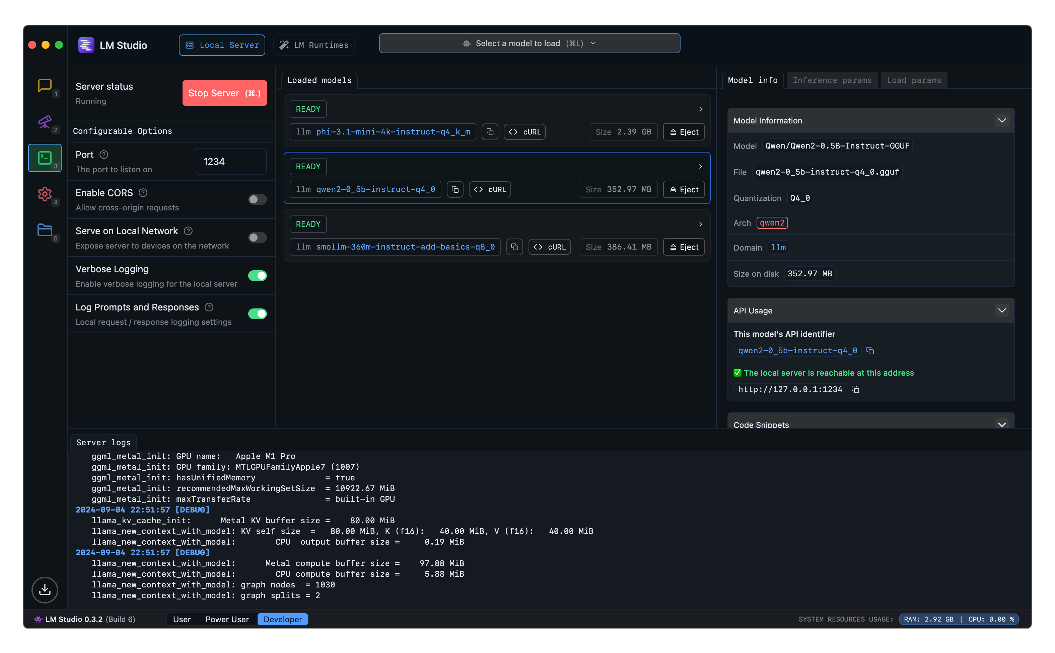

Slide 3
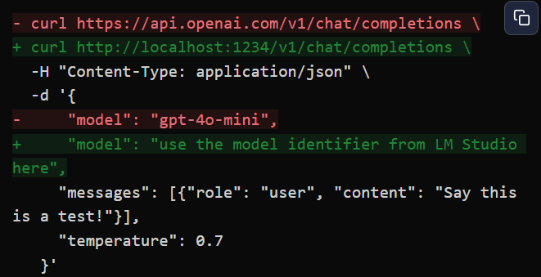

Slide 4
Done in first week:
Locally hosted LLaMa 3.3 70B on FUTURAMA, usable across all machines in the network
Tested different LLMs on coding effectiveness/speed
Qwen2.5:
35.97 tokens/second
Most succinct code
LLaMa 3.3 70B:
3.72 tokens/second
Slowest, solved coding problems DeepSeekLLaMa couldn't
DeepSeek R1 Distill LLaMa 3.1 7B:
123.67/tokens second
Largely ineffective

Slide 5
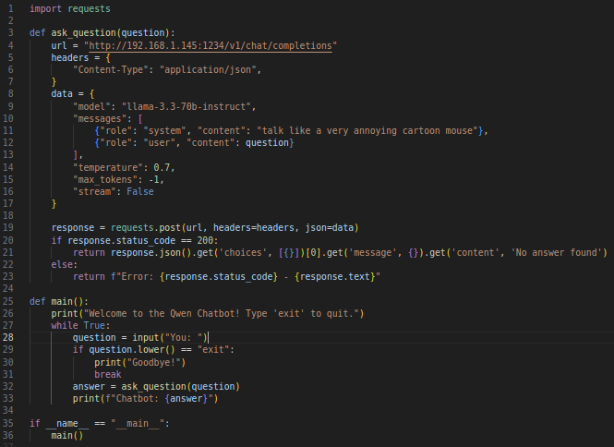
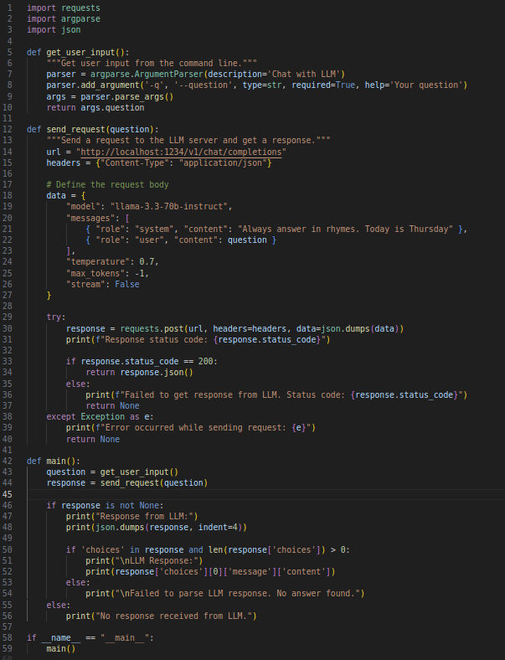
Coding Output
Qwen2.5 (36 lines)
LLaMa 3 70B (59 lines)

Slide 6
Thoughts/Concerns
Little built-in training on HSML across any model:
Solvable in theory; unsure how RAG interacts with teaching new coding syntax (haven't encountered this in prior internships)
Dual use of a JPL-local LLM:
Much easier to test new LLMs without setting up AWS accounts, paying for subscriptions, etc.
Many of the models we can load through LM Studio have new features (tool use!), which may be useful with the Human-Robot Interaction work ongoing

Slide 7
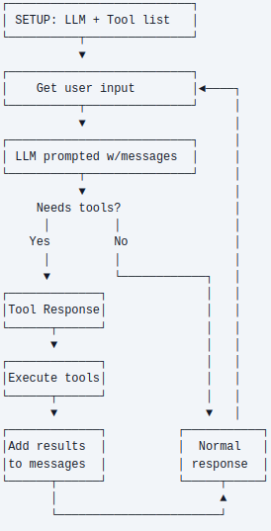

Slide 8

Questions?

